Slide 1

Global Certificate in Data Science
Project for Term -1 & Term- 2
Sanjit Kumar Ghosh
Batch : Feb - 2019

Slide 2
Table of Contents
Detailed Steps for the Project completion
Create a Problem Statement
Feature Engineering
Hypothesis Testing
Conclusion

Slide 3
Detailed Steps from Inception to Conclusion
Detailed Steps for the Project completion
Problem Statement
Data Loading and Description
Data Profiling
Understanding the Dataset
Pre profiling
Pre processing
Data Cleansing
Post Profiling
Questions
Which team has a better win % over others
Does Toss winning have a bearing on the final Match Outcome
Which option post Toss winning has led to higher % of winners
To identify Team/ Teams who is good at chasing Totals and winning
To identify Team/ Teams who is good at Defending Total set for rival teams
To narrow down on the range of winning by runs and or wickets for Teams over the seasons
Establish Co orelation between all the features
Hypothesis: Toss winning and choosing to field first has a good bearing on the final outcome
Conclusion

Slide 4
Data loading , Cleansing and Processing
Problem Statement: To bring out an element of predictability on the winning % of different teams by analyzing the Matches.csv data which has been provided from GitHub
Activities
Steps
Data Loading & Description
Data is loaded from the GitHub location ( https://rawgithubusercontent.com/insaid2018/Term1/master/Data/ Projects/matches.csv )
The Matches Data set has the following
696 Rows of data and 18 columns
Inputs on each match elaborated- Winner, Winning type, season, toss decision and selection etc.
Data Cleaning
The Data loaded was cleaned to ensure the following
The Missing data for ‘City’ column is filled with alternate data
The Missing rows for Umpire3 is dropped since it had around 91% data missing
Few rows- Umpire1, Umpire 2 is dropped & Team names consolidated
Pre and Post Processing
The Loaded Dataset was processed initially as well as post cleaning to ensure there are no Missing values
Preprocessing : This was done to check for hidden issues – Missing data, Team name overlap
Post Processing: This was done to check that the cleansing activity was as planned so that the data is clean and the next step of analysis can progress without any hitch

Slide 5
Glimpse of the Raw Data- Initial Observation
Column | Rows with Data type
id | 696 non-null int64
season | 696 non-null int64
city | 689 non-null object
date | 696 non-null object
team1 | 696 non-null object
team2 | 696 non-null object
toss_winner | 696 non-null object
toss_decision | 696 non-null object
result | 696 non-null object
dl_applied | 696 non-null int64
winner | 693 non-null object
win_by_runs | 696 non-null int64
win_by_wickets | 696 non-null int64
player_of_match | 693 non-null object
venue | 696 non-null object
umpire1 | 695 non-null object
umpire2 | 695 non-null object
umpire3 | 60 non-null object
Observation:
Total 696 rows
18 Column
3 matches did not have a winner- A Tie
One Match had no Umpire (Umpire1 and or Umpire 2 missing)
Umpire 3 had only 60 entries- It could be that the match did not have the provision of Third umpire

Slide 6
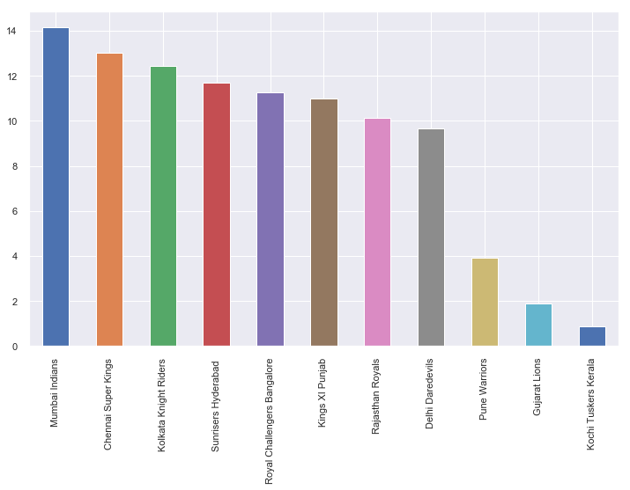
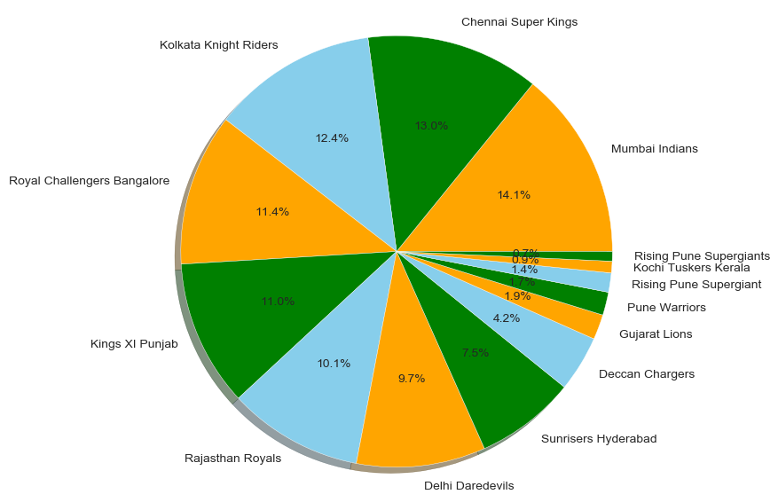
Feature Engineering- Plotting
Identify Teams having better win %
# Inference:
692 matches had a clear winner with Mumbai Indians having a bigger share of 14% winning followed by Chennai Super Kings with 13% and Kolkata Knight Riders with 12.4%
Both Graph give similar views- one in numbers and the other in %

Slide 7
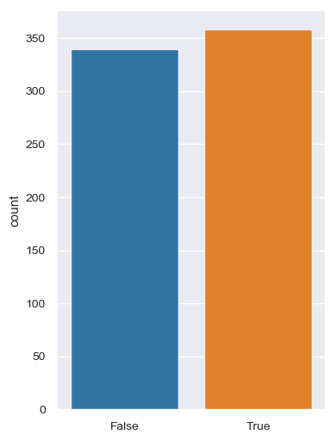
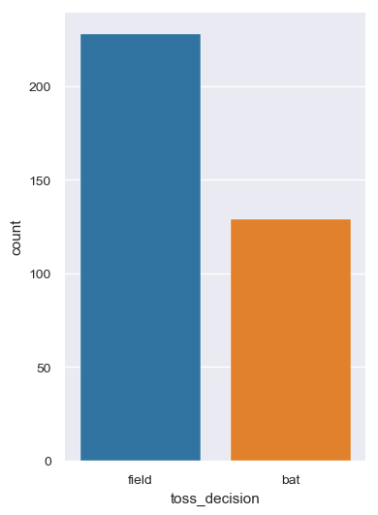
Feature Engineering- Plotting…contd.
To Check Influence of Toss on the Team winning
# Inference:
Winning Toss had clearly influenced the Outcome of matches. Number of matches won by teams who have won the toss is more than those who lost
The Toss Decision- Opt for Field or Bat too had an influence. Those Opting to Field (chase Total) were far more than those who opted to Bat. This resonates with the overall trend of maximum matches in IPL won by Chasing being more than those who Defended (Opt to bat first)

Slide 8
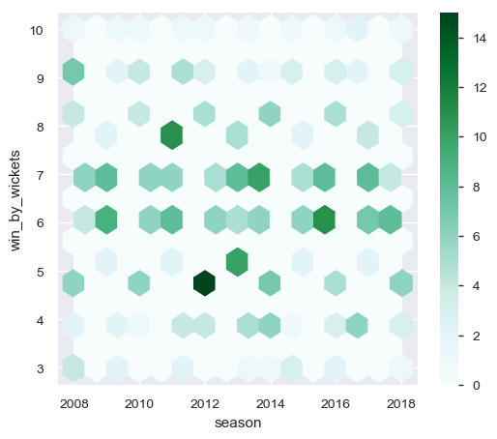
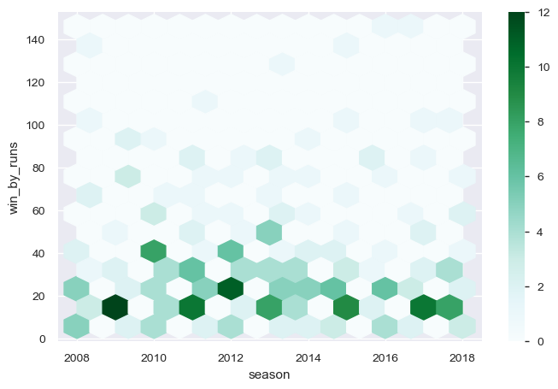
Feature Engineering- Plotting…contd.
Range of Winning
# Inference:
The above two graph provides a view on the Range of Win by Teams
Win by wickets is mostly concentrated at 4- 5 wickets
Win by runs is mostly in the Range of 10- 25 which shows that the matches were closely fought on the field.

Slide 9
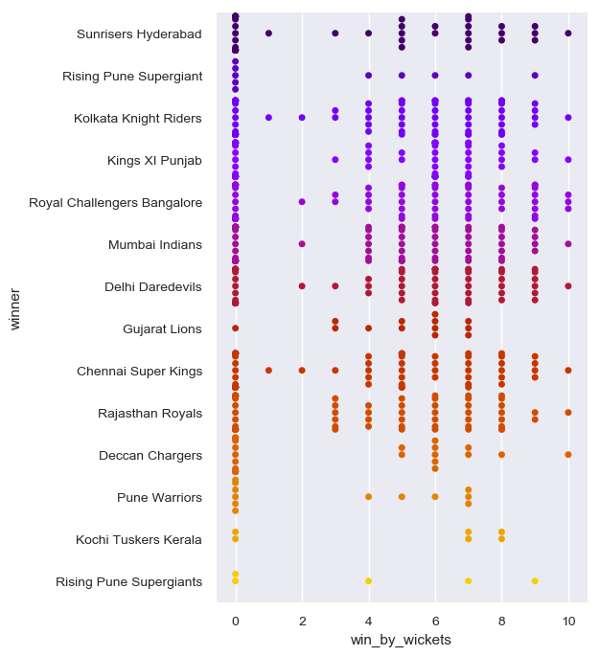
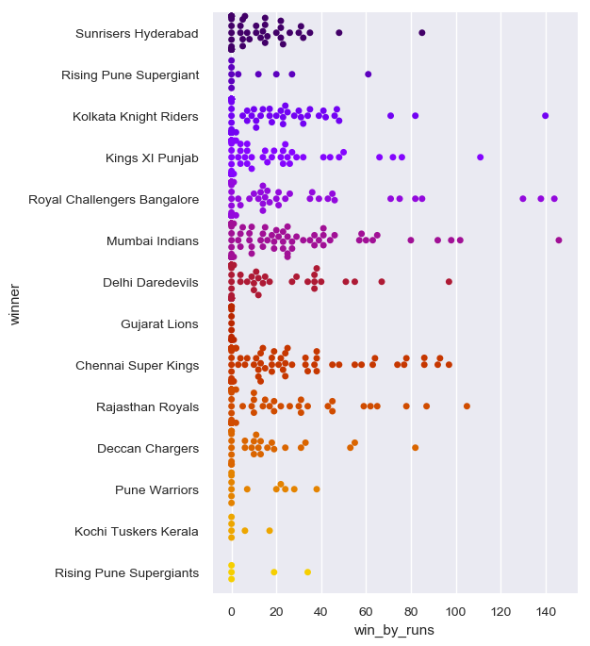
Feature Engineering-Plotting…contd.
Team level proficiency in winning
# Inference:
The above two graph provides a view on the performance of Teams- Winning by runs or wickets
Kolkata Knight Riders seemed to be better at chasing over the seasons followed by Chennai Super Kings and Royal Challenges Bangalore
Mumbai Indians was found best at defending total followed by Sunrisers Hyderabad and Chennai Super Kings.

Slide 10
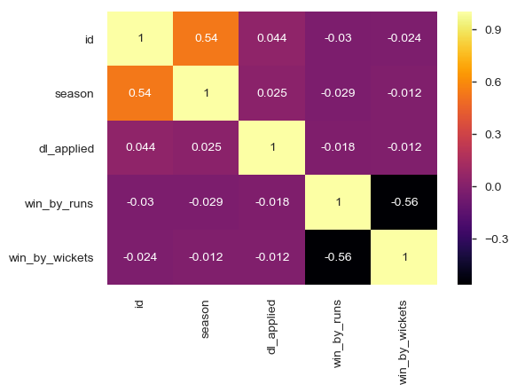
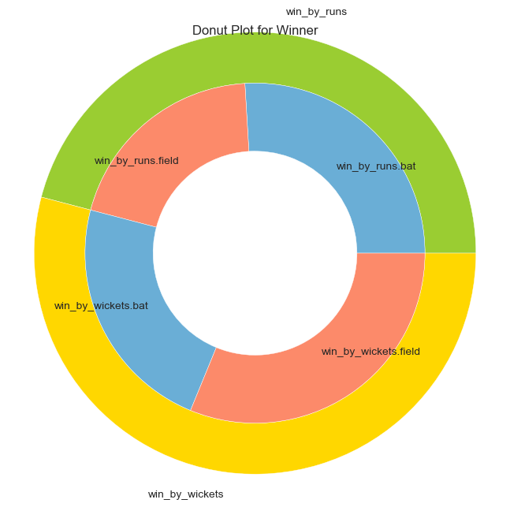
Feature Engineering- Plotting…contd.
Win type and how it relates with Toss decision
# Inference:
The above two graph provides a view on winning type- Win By wickets or runs
The Heat map shows a negative co orelation between win by runs and win by wickets. For one being zero the other is non Zero
The Donut chart was created to further validate the point that winning by Chasing has a better win predictability than win by Defending. The Toss decision to follow accordingly for a favorable outcome

Slide 11
Conclusion
Hypothesis: Toss winning has a good bearing on the winner for a match
Outcome of the Analysis
Based on the analysis conducted on the Matches.csv data, it was observed that
357 matches had a positive Outcome due to Toss- winning going in their favor and with them opting for Batting or Bowling as per the following
Pitch condition
Time of the day (for matches having a start during later part of the evening dew is a factor which helps team batting second)
Over 230 matches had a positive outcome with the winning team selecting to Chase Total by fielding first
Over around 125 matches had winning Team selecting to Defend Total by batting first
A Donut plot was also created to find out details between the two- Win by Runs and Win by Wickets
The Plot clearly shows (Outer Circle) that winning % by Chasing total has been higher than Defending target
A further analysis of the matches won by Chasing Total, the number of matches won by teams who had opted to Field first after winning Toss is higher.
The above clearly shows that Winning by Chasing total is preferred option and the Predictability of winning is higher. Hence the decision to Field first after winning Toss should lead to a favorable outcome

Slide 12
Thanks

